Slide 1
Review Kickoff
Jeff Kern

Slide 2
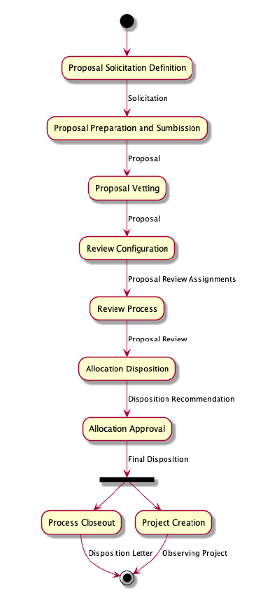
Project Status
TTA 0: Initiation
TTA 0.1: Proposal Creation
  Initial Implementation
  Conceptual Validation
TTA 0.2: Submission and Review
  Observatory Site Review
  Science Panel Review
    Review configuration
    Individual Review
    Consensus Review
TTA 0.3: Time Allocation
  Allocation Disposition
    Preliminary (Schedular)
    Proposed (TAC)
  Allocation Approval
TTA 0.1
The current process
TTA 0.2
In development Target Date: April 2023
TTA 0.3
Detailed requirements under development

Slide 3
Reminder of Key Concepts
Configurability
  Multiple simultaneous solicitations
  Capabilities in each solicitation are modifiable without changes to the code.
Proposals
  Science Justification
  One or more Allocation Requests
Allocation requests contain capabilities and observing specifications
  Capabilities are science focused
    What the user wants to achieve, not how the hardware is used.
  Observations Specifications
    How the hardware could be used to achieve the capability goals.
    Used to derive a time request
“Novice” View
“Expert” View

Slide 4
Review Objective
This system is a realization of a number of new concepts defined in the TTA Tools Concept document. This review is intended to evaluate how well these concepts support the proposal process and if they have been realized in a suitable way.
  Are the concepts of Proposal, Allocation Request, Capability and Observing Specification clearly implemented?
  Is the user interface intuitive and navigable?
  Do the concepts of Capability and Observing Specification support both novice users and expert users?
Not a review of the algorithms or details of the capabilities and generated observation specifications.

Slide 5
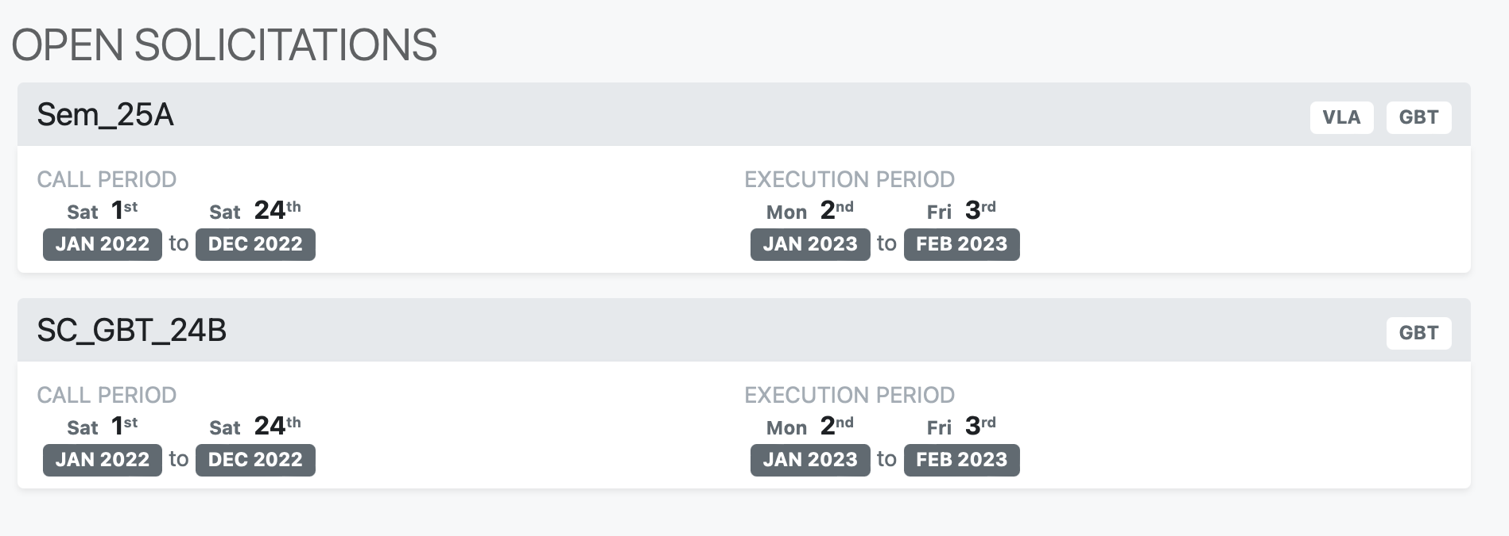
Features and Limitations
Solicitation Configuration
For this review there are two solicitations configured.
Sem_25A: VLA and GBT and is configured for the full range of frequencies.
SC_GBT_24B: Low frequency observations on the GBT.
Configuration of multiple Solicitations that may exist simultaneously with heterogeneous Facility and Capability specifications.
  Currently specified through JSON file.
Limitations:
User configuration of Solicitation is not yet ready for validation and testing.
Only two facilities are currently supported (VLA and GBT).

Slide 6
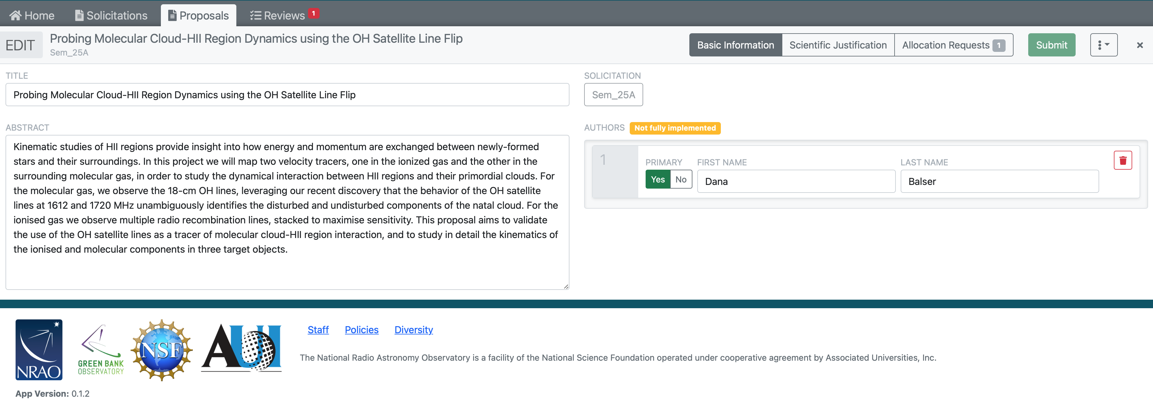
Features and Limitations
Limitations:
The Author specification is not fully implemented.
The uploaded scientific justification is not validated to ensure compliance with proposal requirements (or even that it is a valid PDF).
Proposal validation and submission is not yet implemented
Proposal Creation: Proposal Information
Basic Information (author, title, abstract).
Import of scientific justification PDF with view/delete functionality.
Creation of one or more Allocation Requests.

Slide 7
Features and Limitations
Proposal Creation: Capability Requests
Creation of one or more capability request for each allocation request.
Manual/file import of Field Sources.
Manual /file import of Spectral Specifications.
Manual input of Performance metrics.
  Simple input applying to all targets.
Manual input of Calibration Parameters.
  Per capability options that can inform the expansion to Observation Specification
Advanced tab
  Permits per target refinement of global parameters.
  Configurable which options can be changed on a per target basis.
For this review there are two capabilities defined.
VLA Simple Continuum
GBT Spectral Line
Limitations:
The entry widgets for values have not yet been optimized for formatting or validation.
The hardware capability model has not yet been developed, a simple placeholder is currently used to provide approximate functionality for the purposes of concept validation.

Slide 8
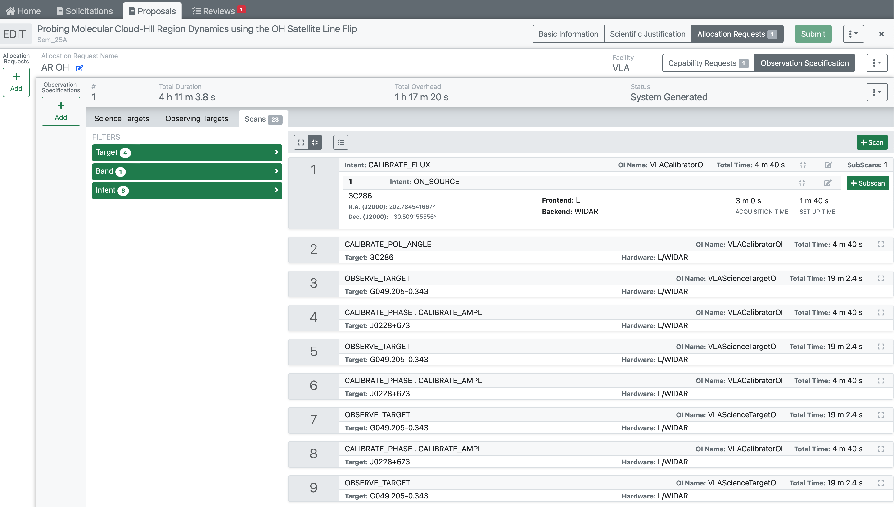
Features and Limitations
Proposal Creation: Observation Specification Creation
List of Scans that could be used by the proposer to achieve their scientific objective.
Used to estimate total time required by Allocation Request.
Limitations:
The algorithms underlying the generation of an Observing Specification from the Capability Requests in an Allocation Request are preliminary.
Observing times, strategies, and calibrators are intended to demonstrate the workflow of the system and are not scientifically valid.

Slide 9
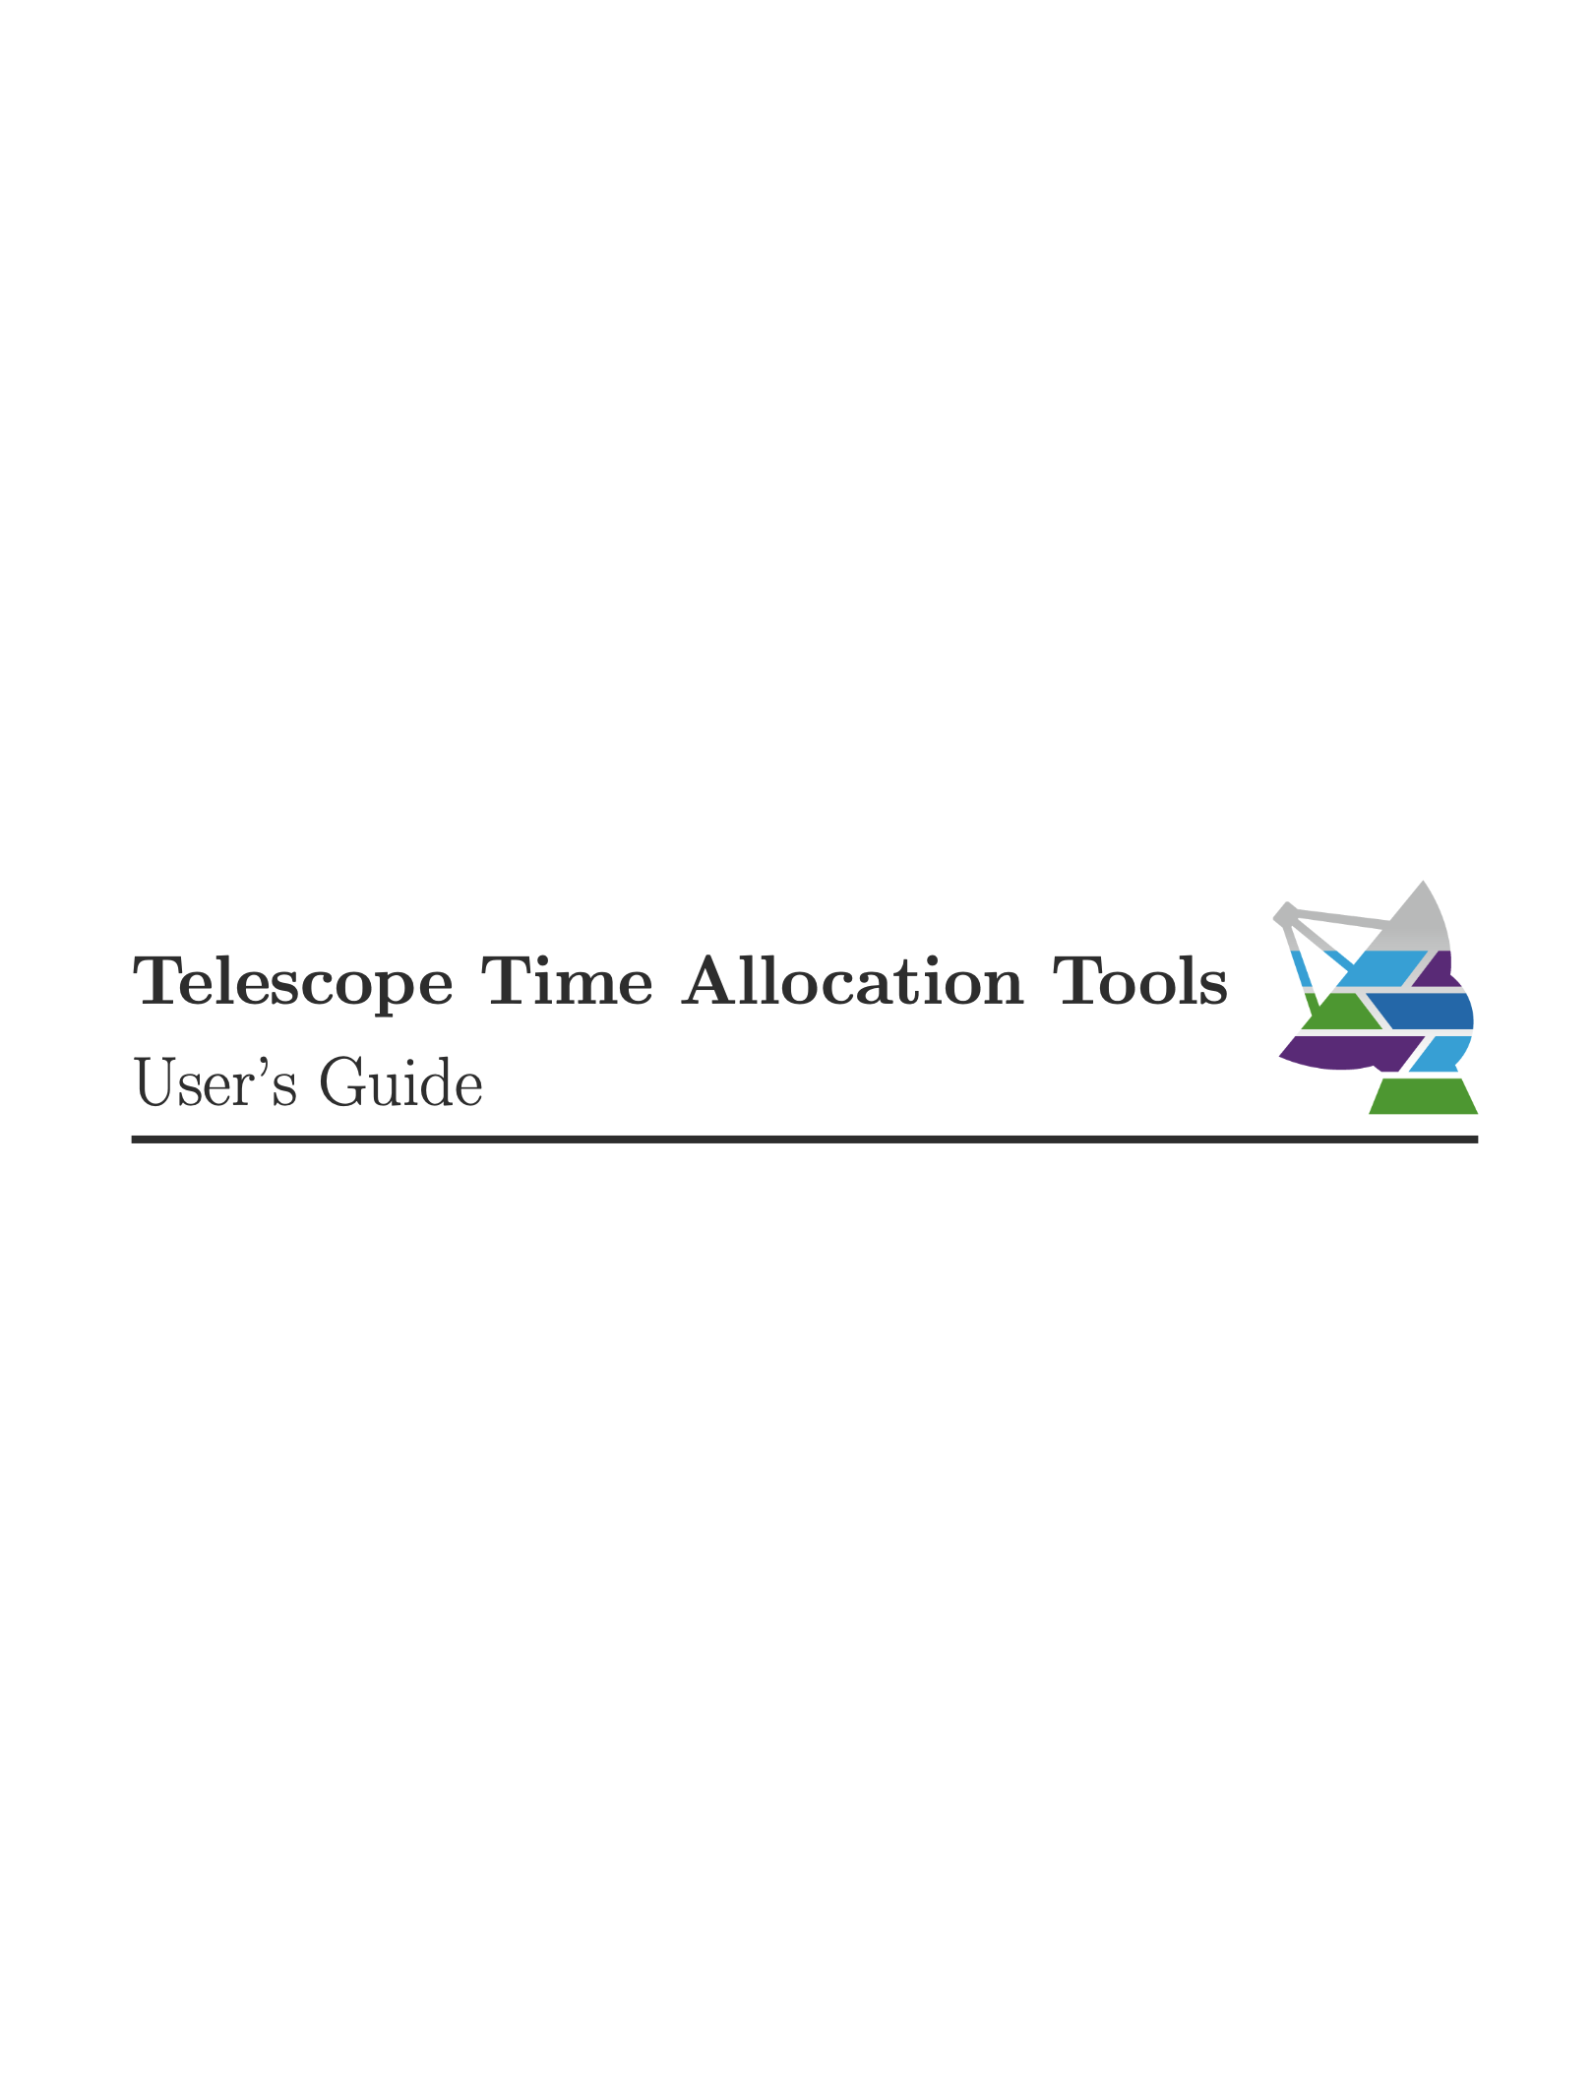
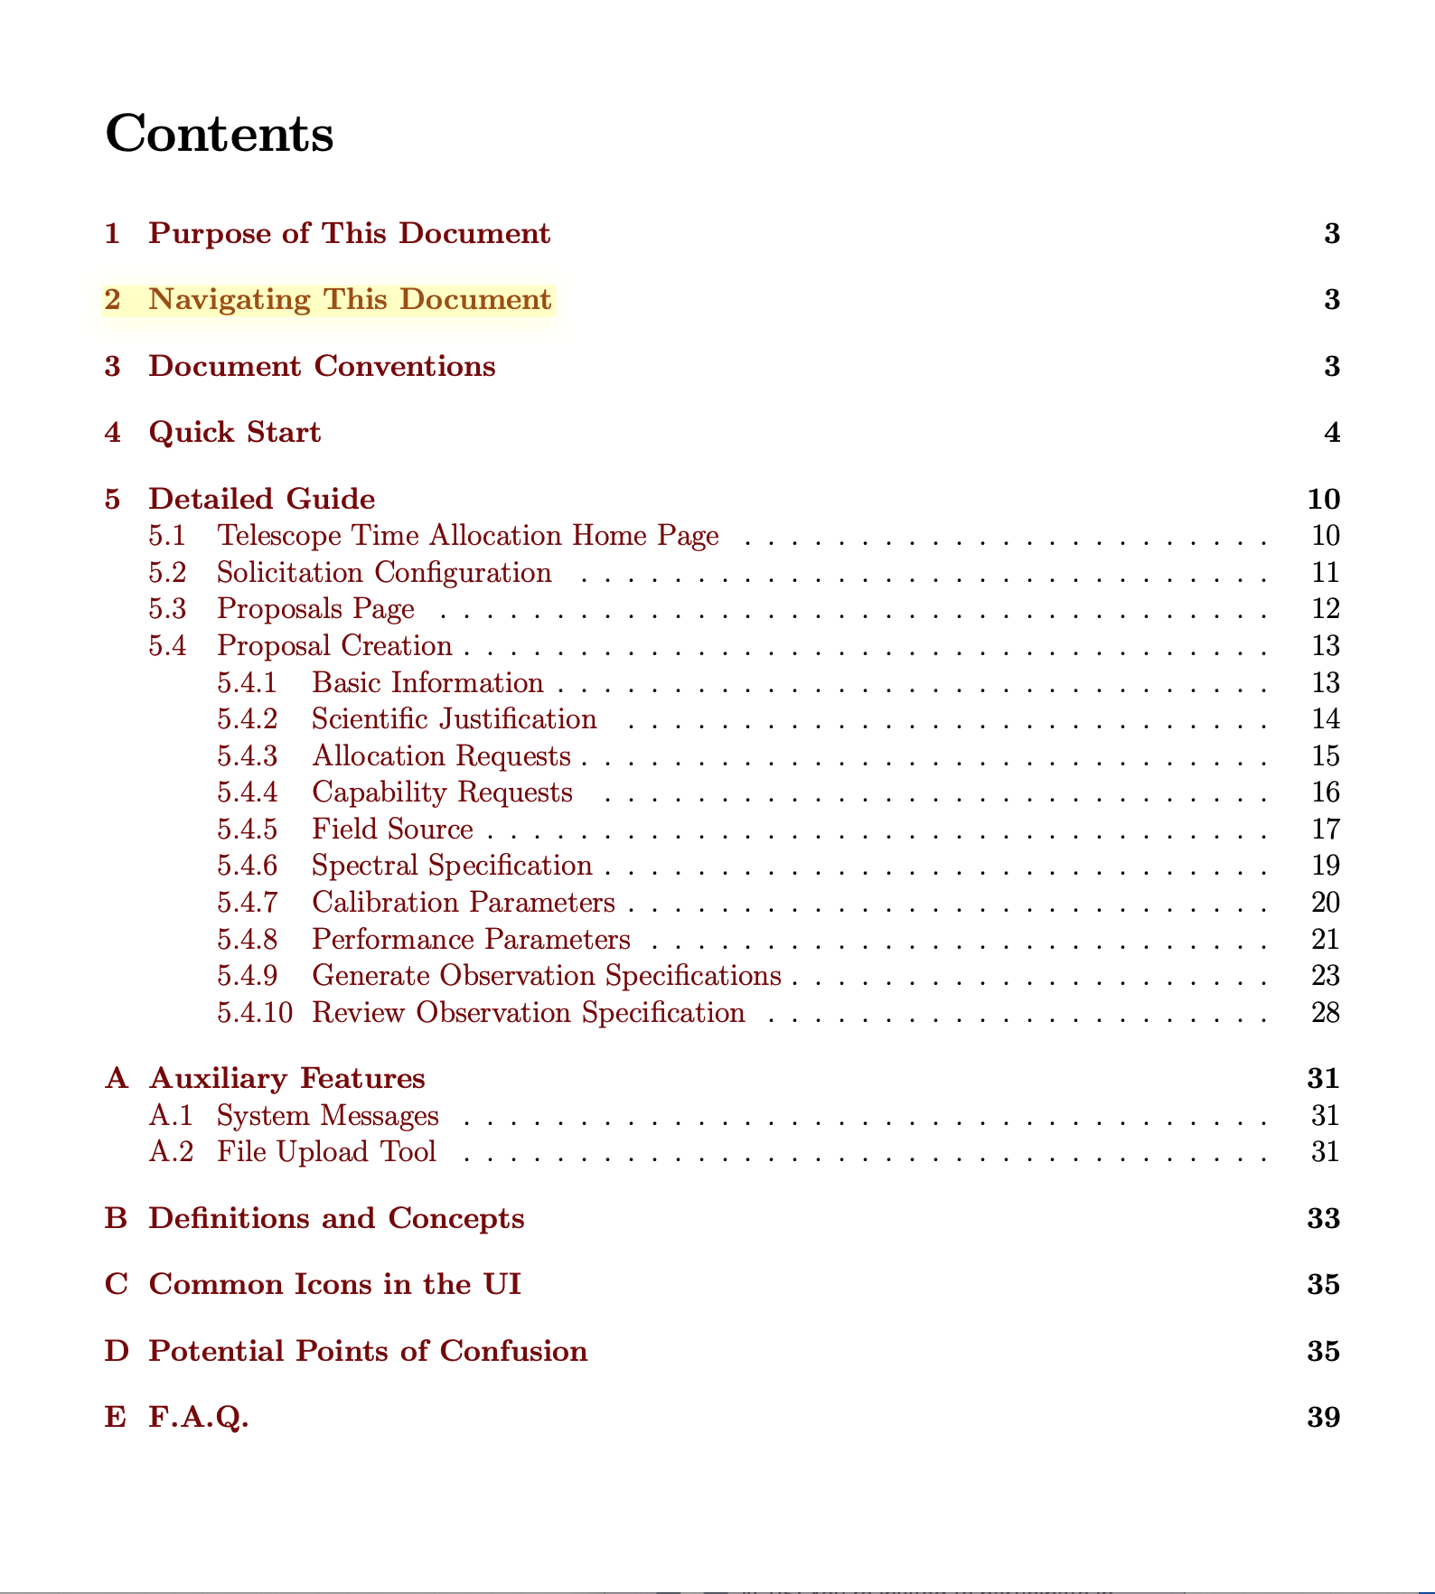
Documentation

Slide 10
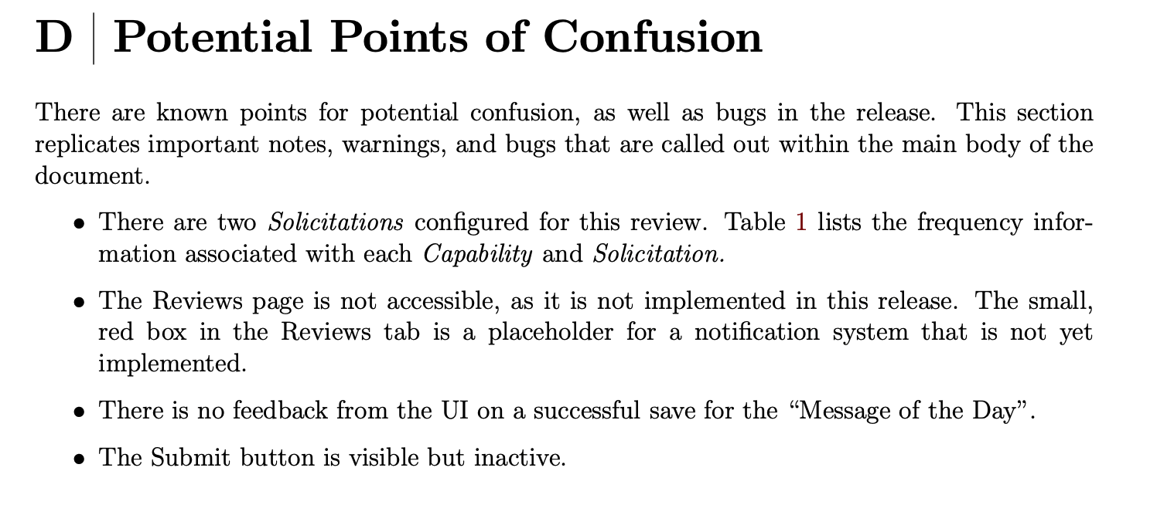
Other Limitations
Entry of Technical Justifications in support of Allocation Requests has not yet been implemented.
Identity Management (login) has been stubbed out although authorization and authentication protocols are in place. Panel Members may select an identity via the interface.
Regular Users
Amy Mioduszewski
Toney Minter
Ryan Lynch
Lorant Sjouwerman
Emmanuel Momijian
Mark Claussen
Allie Costa
Data Balser
Jeff Kern
TTA Group Members
Amy Mioduszewski_TTA
Toney Minter_TTA
Ryan Lynch_TTA
Lorant Sjouwerman_TTA
Emmanuel Momijian_TTA
Mark Claussen_TTA
Allie Costa_TTA
Data Balser_TTA
Jeff Kern_TTA

Slide 11
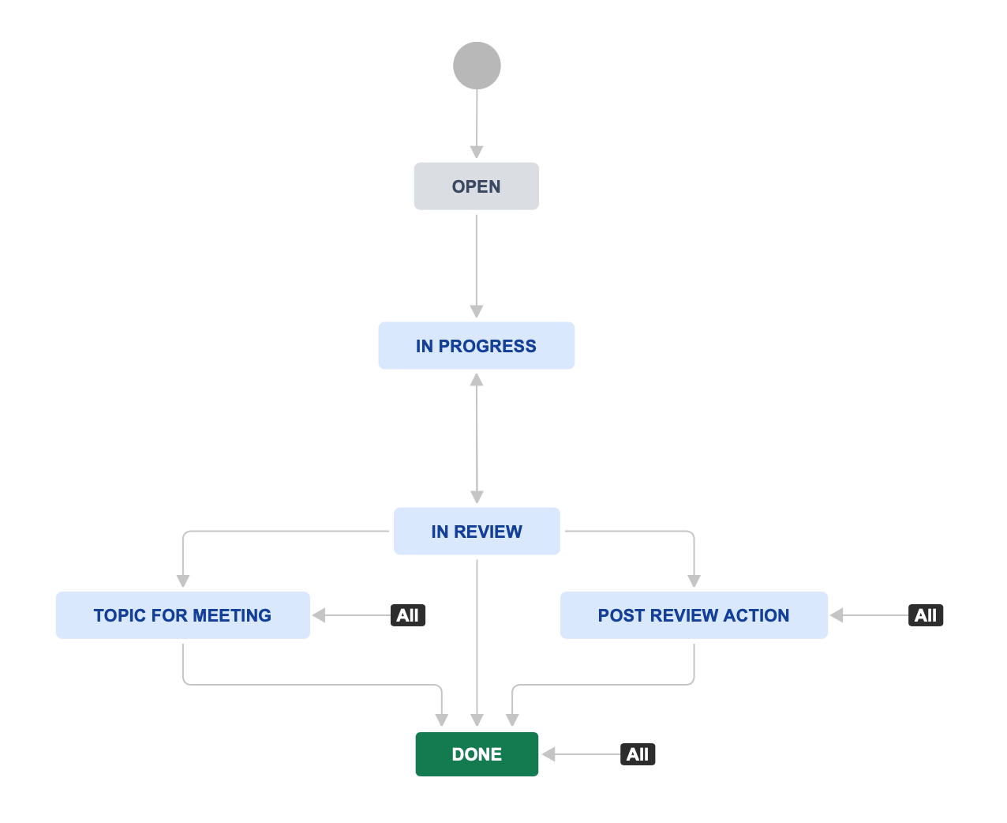
Process
Telescope Time Allocation Landing page: https://tta.nrao.edu
Confluence Page: https://open-confluence.nrao.edu/display/SRDP/Telescope+Time+Allocation+Tool+Version+0.1+Review
  Links available from confluence page as well
Process: Please submit comments and questions via open-jira
  Project: Science Ready Data Products
  Type: Review Item Discrepancy
Please submit your feedback prior to December 5th.

