Slide 1
Architecture
Mark Whitehead

Slide 3
System Description and Architecture
SRDP-521: Resources vs Capabilities
SRDP-514: Definition of ‘resource’
“For each Capability the TTA Group will select the configurable list of resources and their constraint…”
Allocation Request is requesting use of observatory “resources”; a facility offers “Capabilities”…
Problem: relationship between Capability and resource may not be sufficiently clear.
Suggested Action: Topic for Meeting
We intentionally chose the dictionary definition of ‘resource’ to support a variety of facilities (e.g. observing, computing, etc.) in the sense of the capability definition (i.e. the different ways a facility can be operated and the resources available).

Slide 4
Architecture
SRDP-516: Quality Attributes
“On Availability…I wonder if Reliability might be a wider attribute, encompassing that and others such as Recoverability, Fault Tolerance?”
Problem: Did we miss an important Quality Attribute?
Suggested Action: Post Review Action
ADD starts with a QAW to identify, define, and prioritize QAs. Instead, I inferred the QAs and agree that Reliability should have been included for the logical and physical phases.
We should add Reliability to the architecture document in the logical phase and define what it means for TTAT; we should determine how to measure reliability-related metrics in the logical phase and monitor those metrics throughout the physical and deployment phases. (Due: by end of logical phase)

Slide 5
Architecture
SRDP-513: System Context
Problem: The system context models some entities (e.g. generators) as ‘external’ even though they are part of the system that will be built.
Suggested Action: Topic for Meeting
Figure 6 includes the generators as external because I know I need them but I don't have sufficient information to decide how to refine them and where to allocate them in the model.
I don't like that 'external' has two different meanings in the figure but I accepted it because I know the generators will be refined in a subsequent phase and I thought it would be more efficient to have all the 'known unknowns' in one place.
I'm happy to change that based on group consensus.

Slide 6
Architecture
SRDP-520: Missing Project Relationship
Problem: The Propose package is missing a relationship to observing projects (i.e. Proposals must somehow link to projects).
Suggested Action: Topic for Meeting / Post Meeting Action
We concede there is a gap between proposals and projects. Specifically, since all proposals with positive allocation dispositions will result in projects, the association is between the allocation disposition and project concepts.
Since there is insufficient information to model the association now and it isn’t clear what a ‘weak association’ implies, we prefer to clarify the linkage when we refine project creation in a subsequent phase. (Due: prior to Phase 14)

Slide 7
Architecture
SRDP-431: Browser Support
Problem: The requirements specify support for Firefox, Chrome, and Safari. Will this requirement meet the needs of TTAT users?
Suggested Action: Topic for Meeting
We occasionally check in the server logs which browsers are used on my.nrao.edu. This information is used to inform us which browsers are most commonly used and those that we really need to support well. We are working to formalize this process so that it becomes a routine metric.

Slide 8
Architecture
SRDP-430: Peak Server Load Planning
The requirements specify that a server shall be able to handle 140 simultaneous users.
Problem: Are the performance requirements sufficient given an increase in the TTAT user base due to the availability of science-ready data products?
Suggested Action: Topic for Meeting
Is there are recommendation for this metric?
It would be helpful to the developers if we could express this as a Quality Attribute Scenario.

Slide 9
Architecture
SRDP-483: Server Load on Submitted Proposals
The requirements specify that a server must be able to handle 60 proposals submitted within a two hour period but, for 20B, about 80 proposals were submitted in the final hour before the deadline.
Problem: Is the current requirement sufficient?
Suggested Action: Topic for Meeting
It would be helpful to the developers if we could express this as a Quality Attribute Scenario.

Slide 10
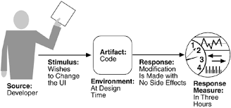
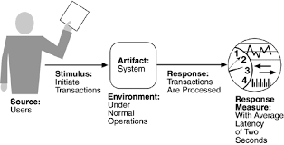
Quality Attribute Scenario
A technique to specify quality attributes that describes a stimulus received by the system and a measurable response to this stimulus. Scenarios are testable, falsifiable hypotheses about the quality attribute behavior of the system under consideration. Completely developed scenarios are described using six parts.

Slide 11
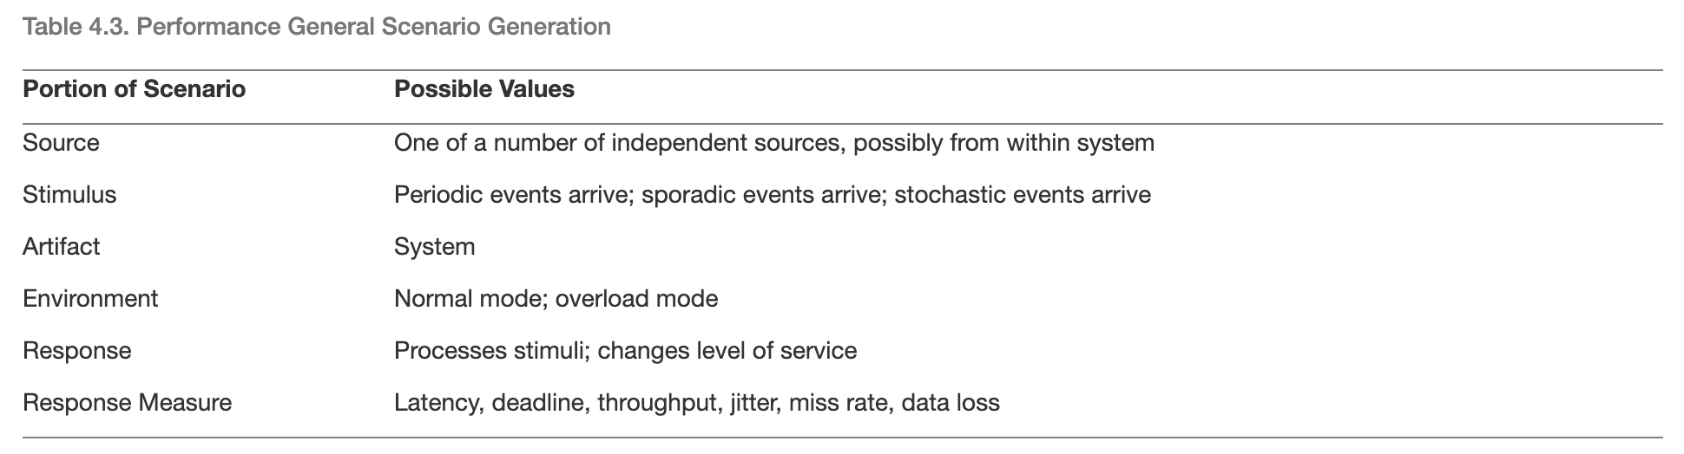
Quality Attribute Scenario

