Slide 1
New TTA Tool Suite
Design Concept
Jeff Kern and Dana Balser

Slide 2
Proposal & Observing Process (Simplified)
Proposal
Creation
Submission
Individual review
Technical
Scientific
Directors' Review
Validation
Data Management
Disposition
TAC Meeting
Review
Time Allocation
Obs Preparation
Project Creation
SB Generation
Observation
Data Delivery
Archive
SRDP Generation
SRP Telcon
Scheduling
Execution
PST
Scope of this Concept
OST
PBT
“Phase 1”
“Phase 2”
GOST
PHT
AAT
OPT
RCT
SCT

Slide 3
Context
NRAO’s TTA tools are:
  Obsolete Software
  Difficult to maintain
  Not user friendly
Users and NRAO all want a new tool suite!
Users really like the ALMA OT
  Significant investment in a new(er) set of tools. (~300k LOC)
    ALMA currently considering a rework of the tool
  Considerable opportunities for overlap
  Potential for alignment with SKA
Need update to achieve goals of SRDP project
  Better capture of observing strategy and intent

Slide 4
Project Scope
Develop and deploy a new suite of software tools to support the submission, assessment, and time allocation of North American
AUI / NRAO Telescopes.
Project initiated 4 years ago!
Necessarily will interact with existing scheduling and observing software and process.
  Developing concept to address this interaction.

Slide 5
Concept
Develop an integrated tool suite that:
  Better captures scientific intent and technical details at the proposal stage.
  Decreases the requirement for detailed telescope knowledge at proposal stage.
    Support generation of observing programs.
  Supports SRDP operations.
  Accommodates the expertise and creativity of the existing radio community while supporting novice users.

Slide 6
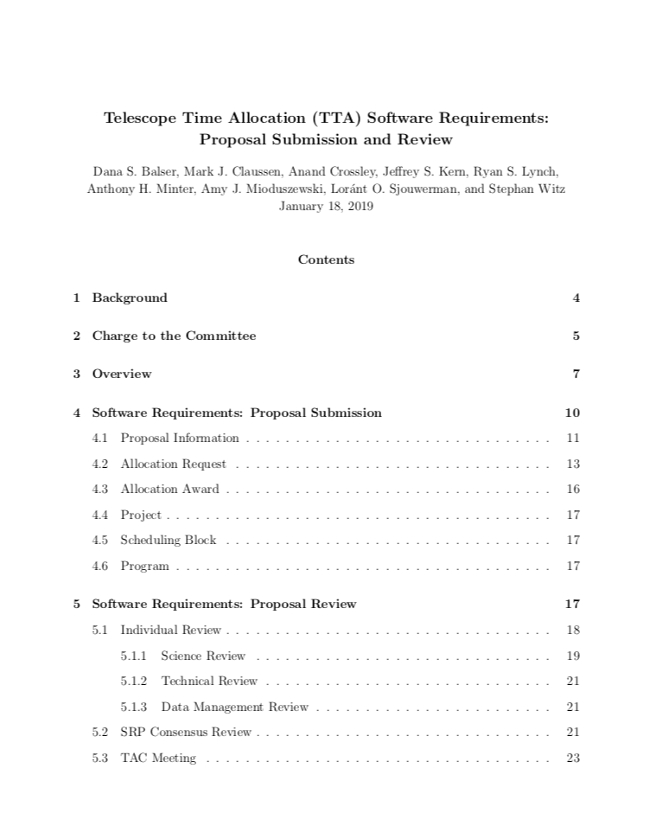
Requirements Committee
Dana Balser (chair)
Mark Claussen
Anand Crossley
Jeff Kern
Ryan Lynch
Toney Minter
Amy Mioduszewski
Loránt Sjouwerman
Stephan Witz
https://safe.nrao.edu/wiki/pub/Software/TTANewTools/ttaToolReq_final.pdf

Slide 7
Boundary Conditions
NRAO/GBO will continue to allocate total telescope time
  Not sensitivity (different from ALMA)
Support proposal, review, and allocation for NRAO Telescopes:
  VLA, VLBA, GMVA, and HSA (HSA treated as separate telescope)
  GBO may “opt in” to the tool
Look and feel similar as possible for all AUI/ NRAO telescopes
  “ALMA Like” for users
  Must be differences (multiple telescopes, etc.)
  Capture enough information at proposal time to be able to generate SBs (Phase 1 – Phase 2 paradigm)
Support for SRDP Generation
  Capture of scientific intent, product parameters
GBO has opted to use the new tool for GBT.

Slide 8
Additional Requirements
Must be consistent with ngVLA operations concept
  https://sharepoint.nrao.edu/ngvla/_layouts/15/DocIdRedir.aspx?ID=NRAO-402-281
  Already must support multiple telescopes, just don’t build it out.
Support for eXtra-Large / Legacy Proposals
  Flexible about calls and capabilities, not hardwire assumptions.
Need to be able to run “dummy” calls
  Community Days / Schools
  Testing and validation
Must be able to support possible future “double blind” proposal review process

Slide 9
Assumptions / Choices
Existing downstream tools (OPT, OST, DSS) will need to be accommodated or modified.
  Concept for addressing this early deliverable from the project
The user facing proposal tool will be Web Based
  like the current PST
  ALMA is likely changing to this design
Review process conceptually unchanged
  Implementation may need to be modified based on changes to upstream tools.

Slide 10
Concept Structure
Proposal
TAC
PI
(Phase 1)
1..*
Allocation
Request
Allocation
Award
Common
Telescope Specific
Project
1..*
Scheduling Block or Session
PI
(Phase 2)

Slide 11
Proposal Tool Concepts
Proposal Information
Identifying and scientific information for the proposal.
Telescope Independent
Contains
Proposal ID
PI, Contact, CoI
  Affiliations
Abstract
Scientific Justification
Review Category
Science Category
Thesis Project?
  Related info if Yes
Related Proposals
Re-Submission
Review Category Options
Observing Cycle (semester)
Directors Discretionary Time
External TAC
  Require basic proposal information required if time approved.

Slide 12
Proposal Tool Concepts
Allocation Request
Each proposal has one or more allocation requests.
  Allocation requests are for observing time on a telescope
    Could also be used for compute, bandwidth, storage or other observatory resources.
  Enough telescope specific information should be captured to allow the observations and processing to be carried out.
    Option for users to edit prior to observation but not required.
External Facilities (e.g., HST) are separate allocation requests.
  Minimal information captured by default.

Slide 13
Proposal Tool Concepts
Allocation Request Contents
Allocation Request ID
Request Type
Request Purpose
Request Cycle
Allocation Category
Allocation Type
Technical Justification
Triggered?
Calibration Method
Allocation Constraints
External Dependencies
Observation Specification
Allocation Request ID
Unique identifier containing:
  Proposal ID
  Resource identifier
Request Type: Specifies the resource being requested.
Examples: VLA, GBT, VLBA, HSA, GMVA, HST,…
Request Purpose: Specifies the goal and data products that are needed.
Examples: astrometry; detection; monitoring; polarimetry imaging

Slide 14
Proposal Tool Concepts
Allocation Request Contents
Allocation Request ID
Request Purpose
Request Type
Request Cycle
Allocation Category
Allocation Type
Technical Justification
Triggered?
Calibration Method
Allocation Constraints
External Dependencies
Observation Specification
Request Cycle: The observing period(s) for which the proposed observation are expected to be observed. DDT proposals should be the current Cycle.
Allocation Category: open-sky or sponsored.
Allocation Type: regular, large, DDT, RSRO.
In the case of DDT subclasses are: exploratory, TOO or EPO.
Check box to specify filler time requests

Slide 15
Proposal Tool Concepts
Allocation Request Contents
Allocation Request ID
Request Purpose
Request Type
Request Cycle
Allocation Category
Allocation Type
Technical Justification
Triggered?
Calibration Method
Allocation Constraints
External Dependencies
Observation Specification
Triggered: Triggered proposals need to specify additional information:
Target type
Origin of Trigger
Trigger event description
Calibration Method: Either standard observatory calibration (SRDP) or user specified.
For user specified an explanation is required.

Slide 16
Proposal Tool Concepts
Allocation Request Contents
Allocation Request ID
Request Purpose
Request Type
Request Cycle
Allocation Category
Allocation Type
Technical Justification
Triggered?
Calibration Method
Allocation Constraints
External Dependencies
Observation Specification
Allocation Constraints:
Fixed Time Observations: A list of windows for the observation. Provisions for “weak” specification and repeated observations.
Windowed Observations: Once started a certain cadence or date range is required.
Night Time Only:
  RFI night
  Solar avoidance
  Thermal stability (GBT Only)
External Dependencies: A place to record information that will be provided later (e.g. Ephemeris for a TOO)

Slide 17
Proposal Tool Concepts
Allocation Request: Observation Specifications
Defines the scientific observations (and products for SRDP telescopes).
Source and telescope specific details.
Contains one or more Observation Specifications consisting of:
  Field: Description of the source position etc.
    Integrated source catalog behavior
  Front-End: Receiver and Array Configuration (if applicable)
  Back-End: Detailed specification of the detectors.
    Integrated resource catalog behavior
  Integrated Time: total time on source
    Not necessarily just from a sensitivity calculator
  SRDP Product Specification (if applicable)

Slide 18
Proposal Tool Concepts
Allocation Award
Each Allocation Request has a corresponding Allocation Award.
Assigned at the end of the TAC process
Proposal disposition is determined on a per allocation request basis.
Contains
Linear-rank score
Scheduling priority
Time allocation
(optional) scheduling constraints

Slide 19
Proposal Tool Concepts
Phase 2: Project Creation and Observing Preparation
Formally out of scope of current concept document.
Very telescope specific, concept still TBD.
Assumptions:
For Proposals with positive Allocation Awards.
  Separate projects are created for each allocated request.
  For SRDP telescopes the initial Scheduling Blocks are created.
    “Programs” are created to group execution blocks for subsequent pipeline processing.

Slide 20
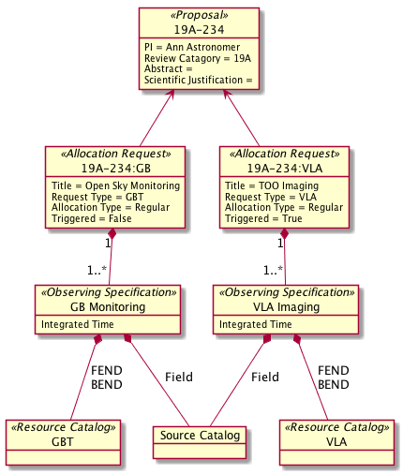
Proposal Tool Concept
Example
Consider a monitoring campaign using the GBT which if a change is detected in one of the sources would trigger a TOO observation on the VLA.

Slide 21
Next Steps
Concept introduction (this): March - May
Internal Concept Review: May
Users Committee Meeting: June
Conceptual Design Review: October

Slide 22
Internal Concept Review
How to participate:
Download (and read) the concept document:
  https://safe.nrao.edu/wiki/pub/Software/TTANewTools/ttaToolReq_final.pdf
Enter questions and comments through Jira:
  www.open-jira.nrao.edu
  Project: Science Ready Data Product
  Issue Type: Review item Discrepancy (RID)
  Component: TTA Tools Internal Concept Review
Attend the meeting in early May to discuss unresolved issues.

Slide 24
New TTA Tool Suite
Preliminary Effort Estimate
Module | Lines of Code | Java Code | FTE-Years
PST | 147315 | 93764 | 19.6 (12.5)
OPT | 27681 | 20151 | 3.7 (2.7)
RCT | 13753 | 8761 | 1.8 (1.2)
SCT | 16940 | 12856 | 2.3 (1.7)
Total | 205689 | 135532 | 27.4 (18.1)
Assumption: 29 SLOC per day or ~7.5k LOC per FTE-Year
  ALMA had a net of 852,460 SLOC over the interval from 2005-2013.
  Includes managers, testers, etc.
For comparison: ALMA-OT is ~300k SLOC (~40 FTE-Years)

Slide 25
New TTA Tool Suite
Development Context and Approach
ALMA Development Project in prep to update technology for ALMA-OT
  May actually face opposition because the OT is so popular.
SKA may re-use some of the same framework for that tool.
  Both being developed at UKATC
Software stacks are largely compatible, collaboration possible
  Examples: Spectral and Spatial Viewers, Source tools
NRAO is attempting to determine a staged approach
  Limited functionality as soon as possible.
  Add functionality in a number of stages.

