Slide 1
Science Ready Data Products -CoDR
Requirements
Jeff Kern

Slide 2
Requirements Review
SRDP-80
Stakeholder Requirement Review has been progressing in parallel to this review.
All members of the UC and CASA UC were invited to comment on the system concept.
  Document provided March 19
  Deadline moved to April 23
    Avoiding JWST and ALMA deadlines)
Total of 59 Issues, comments, and questions.

Slide 3
Themes and Major Items from Review
Note: This is my distillation of the issues.
Explore data without download.
More willing to be constrained if products are provided
  Large Project case for instance
Weblog
  Needs improvement
  Currently optimized too much for experts
Proprietary Period - Discuss
Concern over resources for optimized imaging
  Reflects more acceptance than anticipated
Note about balancing software quality and capability
StRR process is nearing completion, overall impression:
  No push for a change in direction or major change to requirements
  Feedback on important details, clarifications, priority issues.

Slide 4
Priorities (and MVP)
SRDP-33
SRDP-129
Unambiguous Priority Statement from the Requirements Review
  VLA Standard Calibration Pipeline
  Restore Capability (ALMA and VLA)
  VLA Standard Imaging
SRDP-129: Define Project Level MVP
  Agree with the suggestion.
  MVP will be defined by those requirements derived from the above use cases.
  Proposed Action: Create MVP as discussed above.

Slide 5
User Representation
SRDP-30
SRDP-126
SRDP-137
Inputs
  Radio Astronomy community is represented by UC
    Advisory to the project (but has the Director’s attention)
    Annual Meetings and Telcons progress and solicit input.
    Stakeholder Requirement Review
  Non-radio Community
    Difficult to identify, particularly before we have products
    Contact will evolve as project delivers capabilities
    Promote SRDP at AAS and to other general Astronomy audiences
Definition and Prioritization
  Primary role of Project Scientist
  Stakeholder Requirements Committee supports PS and provides diverse perspectives.

Slide 6
Requirements Metrics and “Use Case”
SRDP-55
Remaining MOE and means to obtain effectiveness data
The System Architect is building the SRDP architectural model in SySML. The requirements were drafted before the model was in place, so we are in the process of defining the metrics within the context of the model.
How do Use Cases fit into the requirements flow down?
We used “Use Cases” in the
System Concept, perhaps not
the best choice of words
System
Concept
Diagram Shows how
the Architect is defining
Use Cases at the System
Req. Level
Stakeholder
Requirements
Document
Use
Cases
System
Requirements
System Architecture
Interactions
System Element
Requirements
System Elements
Interfaces

Slide 7
Issues from the Requirements Review
SRDP-24
SRDP-65
Digital Object Identifiers
Standards
  There is a AAS working group working on defining standards for DOIs.
  NRAO / SRDP is participating in the discussion and will adopt the standard once it emerges.
Comment from StRR:
‘Curation and reproducibility' use case not necessarily useful for the general users.
  We consider this a primarily user facing capability.

Slide 8
Issues from the Requirements Review
SRDP-91
Proprietary Period
Concern: Proposed period puts small schools at a disadvantage.
Three Options:
Make the proprietary period of the SRDP reflect the underlying data. (The one in the document).
Tie the proprietary period of the data to the release of the SRDP.
Allow the Data and SRDPs to have their own proprietary period.
Unpopular to have raw data and not release it until SRDPs are available.
But if data is public then the optimized interface could be used.

Slide 9
Issues from the Requirements Review
SRDP-92
Responsibilities / Person Power
Concern: Who does the work to improve capabilities.
  Improvements to capabilities are defined by the heuristics team
  Implemented within DMS (so CASA, Pipeline, SSA as appropriate).
Concern: A lot of the Use Cases require staff to check that what is produced is good. …probably OK for anything that is going to be stored in the archive …gets unwieldy if every … checked by staff.
  Not all checks need to be the same, some can simply be for successful completion.
  Important to support non-expert radio astronomers to ensure they do not receive misleading products.

Slide 10
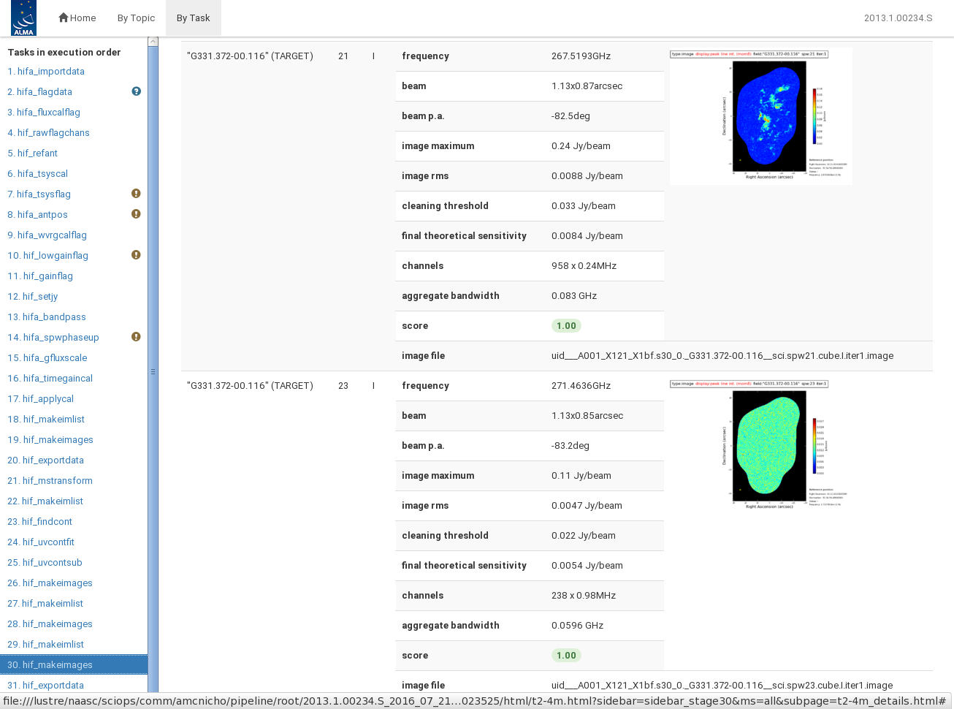
Issues from the Requirements Review
SRDP-69
Improving Weblog is Important
Concern: So much information there that it is nearly impossible to sort through.
The weblog is designed to have a hierarchal structure so that the same report can serve all users.
Current structure heavily influenced by commissioning needs and power users.
“Topics” tab is currently under-utilized.
  Intended to give casual user a summary view
  Effort required to define that summary
  Agree that this is part of SRDP scope

Slide 11
Pipeline for all VLA Receivers
SRDP-52
Concern: ... clear identification of whether ALL JVLA receivers will be included in the SRDP calibration and imaging.
The objective is to support all receiver bands.
Start with the “easy” bands then move into the more difficult portions of the spectrum.
Tension between bands and capabilities.
We plan to use the NRAO users committee to help with this prioritization. The guiding principle will be to maximize the scientific output of the facilities.

Slide 12
High Level Non-functional requirements
SRDP-136
Determined that it is premature to define non-functional requirements.
  Modifying or augmenting existing services
  Uncertainty in pipeline performance
Incremental delivery allows us to baseline performance, then address under continuous process improvement
  Defining performance requirements at the L1 level in subsequent planning waves.

Slide 14
SE Processes for revisions to previously implemented requirements
SRDP-128
Two levels of Change Control Board:
  NRAO CCB: Observatory Level for changes to approved baseline
  SRDP CCB: Project level for changes within approved project baseline
L0 changes typically impact baseline – NRAO CCB
L1 changes typically have minor schedule impact, repurpose resources, or other changes that do not impact the approved baseline – SRDP CCB
L2 changes are managed within a departmental process and are not submitted to CCB, however, notification of L2 changes are tracked by the Project office
Changes to previously approved / implemented requirements are reviewed by the Requirements Committee for re-introduction to a subsequent planning wave as needed.

Slide 15
SRDP Requirements Committee
Current Membership
SSR
Drew Medlin
Eric Murphy
DMS
Rafael Hiriart
Daniel Lyons
NM OPS
Josh Marvil
Claire Chandler
ALMA
Catarina Ubach
Amanda Kepley
Observers
Walter Brisken
James Robnett
Acting Chair: Jeff Kern

