Slide 1
Science Ready Data Products -CoDR
Implementation
Jeff Kern

Slide 2
Risk Management Plan
SRDP-28
Concern: I don't see the risk component of rolling wave addressed - there is a risk register, but I don't see a risk management document.
We are following NRAOs SOPs
  Risk management at the project level is primarily accomplished through prioritization and scope/schedule tradeoff.
  Risk that affects project baseline is carried to the observatory risk register and tracked there.
We see rolling wave as a technique for managing the unknowns in the project (and the associated risk).

Slide 3
VLA Calibration Pipeline
SRDP-74
Concern: Effort required to advance VLA pipeline state
Required Improvements:
  Flux bootstrapping:
    Solution developed for VLASS, needs generalized for general pipeline.
  Sub-optimum for spectral line
Need to perform detailed QA on all projects to asses suitability.
RFI Issues
  TFCrop / RFLAG automation
  New algorithms from ARDG
Risk: Staff for the heuristics portion are currently committed to VLASS
Opportunity: VLASS experience folds back into the pipeline design
  Flux Bootstrapping
  RFI induced compression mitigation

Slide 4
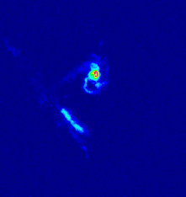
Development Roadmap
SRDP-74
SRDP-93
Early-Project (2018-2019.5)
VLA Science quality Calibration
  Pipeline Improvements
  Process changes
Large Project Ingest
Input to PST/OPT rework
QA Definition and Improvement
Infrastructure and Archive Interface
  Restore Capability
  Optimized Imaging (ALMA)
VLASS and ALMA continue to advance pipeline capabilities.

Slide 5
Deployment Roadmap
SRDP-74
SRDP-93
Early-Project (2018-2019.5) Detail
Note: Years differ between capability development and deployment
Wave 1: Deploy 2019
  VLA Calibration Pipeline is available
    Consumes most of the DA effort.
  VLA and ALMA restore case
  Test cases of optimized imaging for ALMA
Wave 2: Deploy 2020
  More optimized imaging for ALMA
  Restore in use for both telescopes
  Recalibration starting to turn on
Wave 3: Deploy 2021
  Optimized imaging for VLA (limited scope)

Slide 6
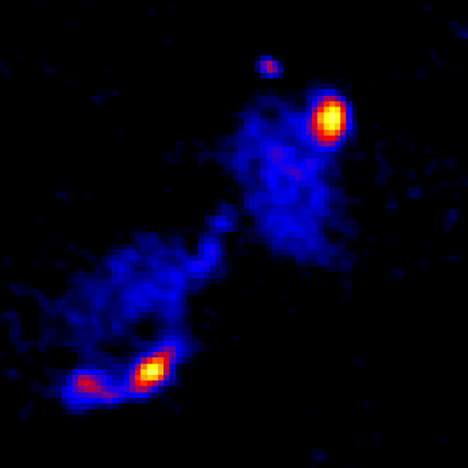
Development Roadmap
SRDP-74
SRDP-93
Mid-Project (2019-2021)
VLA Calibration Pipeline Maturing
  More modes and bands
  Redesigned PST coming on line with process changes
    Beginning of Time Critical Use case
Recalibration workflows
Begin optimized Imaging for VLA
  Significant intervention expected
Minting of DOIs for Users

Slide 7
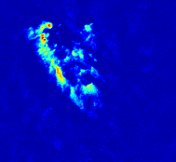
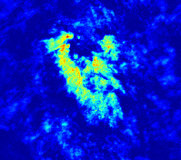
Development Roadmap
SRDP-74
SRDP-93
Late-Project (2021-2022)
Standardizing operations
Expanded support for Large Projects
Standard imaging for VLA
Image Combination

Slide 8
Online Viewer
SRDP-104
Producing an online viewer is out of scope for SRDP.
  Will need to identify a suitable one to reuse.
CARTA is intended to replace the CASA viewer and be a online cube analysis tool.
  Lead development at ASIAA
  UI Design led by SKA-South Africa
  Target delivery: 6 months
Backup plans:
  Aladin Lite (but missing spectral access)
  ?
Added to risk register to track as necessary.

Slide 9
DMSD Process Background
Priority Setting

Slide 10
DMSD Process Background (2)
Time

Slide 11
Development Structure
SRDP 53
SRDP 27
Section 2 – PMD requirements
Section 4 – Agile and Rolling Wave
Diagram of relationship between SRDP and DMS organizations
PMD reference is to a historical study that helped in establishing the path we are following to better organize development across the DMS groups
This is an ongoing effort to standardize as appropriate both within and across the groups
SRDP will help drive closer collaboration across DMS to deliver integrated products
Sample delivery schedule, groups use appropriate development methodologies to deliver into releases:
Notes:
JIRA – makes work trackable, planning easier – implemented on all teams

Slide 12
Development Structure
SRDP 53
SRDP/DMS Development Structure
Diagram shows where the responsibilities reside
In practice there will be interaction on many levels across the organizations and with a variety of stakeholders
Escalation path for issues flows along parallel management paths (AD’s) to the Observatory Director

