Slide 1
Science Ready Data Products CoDR
Context
Jeff Kern

Slide 2
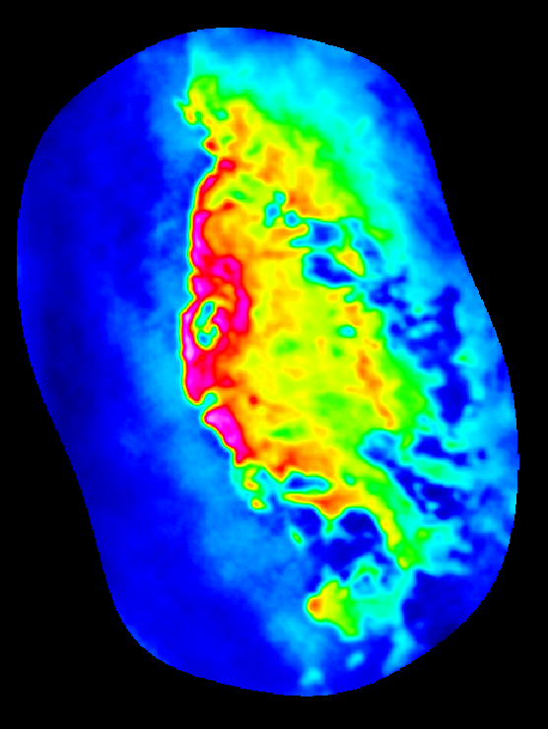
Conceptual Design Review
Thank you!
  We appreciate your time and effort.
  All of the RIDs have been thoughtful and helpful

Slide 3
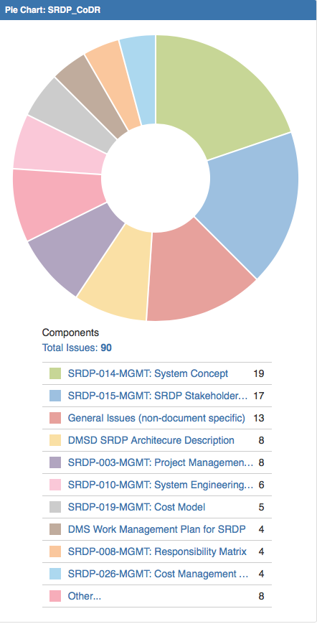
RID Summary
Total of 90 RIDs submitted
  Good coverage of the document package

Slide 4
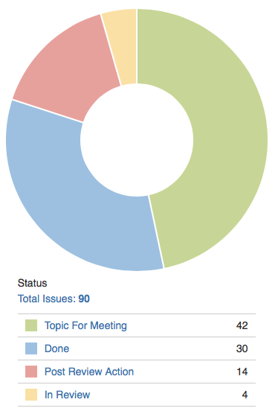
RID Status
Objective of this meeting is:
  Address gaps, uncertainties, or areas that you would like more information on.
  Transition all of the open RIDs to either:
    Action Item: With an agreed action
    Done

Slide 5
Context and the Big Picture
SRDP-34
SRDP-121
SRDP-34: Tangle of Documentation
SRDP 121: How does SRDP fit into NRAO

Slide 6
SRDP Project Organization
Project Like
Not-Project Like
System engineering discipline
  Requirements traceability
  But still a science software project
Project Management and tracking
Design Reviews
Acceptance Process
Fixed spend rate
  Carved out of operational funds.
Becomes standard NRAO operations
  Process Improvements
  Including much of the implementation.
Substantial research component of project.
Resources are matrixed
Addition of operations nearly immediately.
Agile
Not a perfect fit (operations)

Slide 7

Clarification of Project Scope
SRDP-12
Feedback
Specification
SRDP Operations
Process
Refinement
Implementation
Capability Development
Execution
Validation
Science Ready Products
The project is doing two things at once. Producing the tools and processes (capability development) and using those to give feedback and produce products.

Slide 8
Telescope Organization
Science Ready Data Products
Telescope
ALMA
VLA
VLBA
Governance
JAO
NRAO
Software Support
ESO JAO NAOJ
Data Management and Software
Science
Support
ESO
NAOJ
NA ARC
VLA/VLBA Science Support

Slide 9
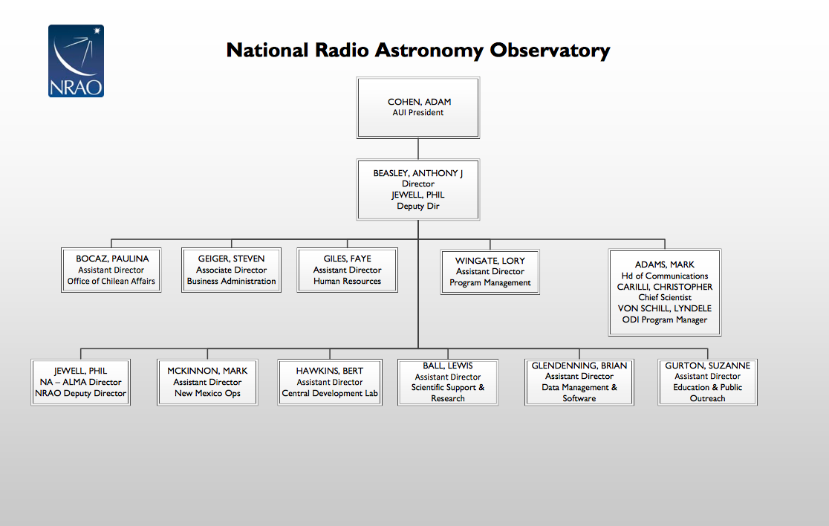


NRAO Organization
SRDP-11
5/9/18
SRDP CoDR – May 10-11, 2018
9
9

Slide 10
Science Ready Data Products
SRDP-49: Role of Program Manager
SRDP-123: Closeout
Internal Organization
Assistant Director
NA ALMA
Phil Jewell
Assistant Director
SSR
Lewis Ball
Assistant Director
NM Ops
Mark McKinnon
NA ARC Manager
Anthony Remijian
SRDP Project Director
Jeff Kern
Program Manager
Mike Shannon
Array Science Center Head
Bryan Butler
Project Manager
Bob Treacy
Data Analyst Manager
Catarina Ubach
SRDP Operations Manager
SRDP Project Scientist
John Tobin
VLA Sci. User Support Lead
Emmanuel Momjian
VLA Sci. Support Lead
Bryan Butler (interim)
Data Analyst (NAASC)
Scientist (NAASC)
Data Analyst (NM)
Sci. User Support Group Scientists (NM)
Sci. Support Group Scientists (NM)
SSR
NAASC
NM
PMO

Slide 11
Project Context
This project seeks to change the way the observatory operates.
  System concept sets the broad outline, but lots of unknowns
  Entire project structure is designed to manage this risk
    Rolling waves
    Operations included
    Incremental Delivery
    Matrixed Level of Effort
Observatory is committed to accomplishing this goal
  Heuristics represent
    26% of available scientist effort in the NA ASC
    14% of available scientist effort in NM ASC
  Data Management:
    60% of primary affected groups development effort
      Excludes maintenance effort
  Operations staff (Data Analysts) already being hired

Slide 12
User Documentation
SRDP-58
Concern: Who prepares end user documentation for SRDP products?
User Support is allocated to a specific group for each telescope who maintain the documentation.
  This is reflected in the RACI by allocation of documentation to the ADs (assume they delegate).
  The SRDP project will need to support them in creating the documentation.
This is an interface that is not defined in the documents.
  To me it will most naturally fit into the operations plan as preparation of documentation will be part of the release process.

Slide 13
Responsible Parties
SRDP-51
Concern: Expected to see responsible party for each line.
I used Wikipedia for my definitions:
Responsible: Those who do the work to complete the task. There is at least one role with a participation type of responsible, although others can be delegated to assist in the work required.
Accountable: The one ultimately answerable for the correct and thorough completion of the deliverable or task, and the one who delegates the work to those responsible.
In cases where there is only an A and no R the Accountable and the person who does the work are the same person.
Link to RACI Matrix

Slide 14
Clarification of Document Set
SRDP-10
Are the SRDP Roadmap and Release Plan in separate documents?
Clarify inconsistent references to L0 requirements documents
Edits made to the following documents, to clarify location of Roadmap and references to L0 Documents (more details regarding edits in Jira ticket):
System Concept Document
System Engineering Management Plan
Project Management Plan
Edited Requirements Hierarchy in SEMP as follows:
Science Drivers and high-level goals
L0 System Concept Document (narrative)
L0 Stakeholder Requirements (formatted for Tracking and Metrics)
L1 System Level Requirements
L2 System element / task level requirements

Slide 15
Clarification of Document Set
SRDP-15
Where are the WBS, Test Plans, Maintenance Plan, & Configuration Management Plan; typically provided in a design review?
WBS – SRDP has alternately defined deliverables through the Requirements Hierarchy, Capability Roadmap, and System Architectural Model within the constraints of the Cost Model
Test Plans – Validation is incremental, progressively delivering capability and verification of L1 Requirements with each release, incorporating community feedback to ensure community expectations are met
Maintenance Plan – Maintenance is performed within the operations phase;
  SRDP Operations Manager will write the Operations Plan when recruited ~Aug 2018.
  DMS references maintenance processes and resource commitments.
Configuration Management – SRDP will use standard observatory CM
  CM and production deployment is in transition from the Software Development Team to Computing and Information Services (based on RH Ansible).
  Software is already held in version control and deployed automatically.
  Deployment configurations are also moving into Ansible (or an alternate automation tool)

Slide 17
Interfaces with External Organizations
SRDP-131
The PMP states: "...supporting departments shall be advised to track their risk independently...".
Concern: Interfaces with external organizations such as DMSD should be formalized through ICDs or Memoranda of Agreement.
Response: I am not certain that this level of formality is warranted. The Data Management and Software Department (DMSD) is internal to NRAO, as are the other Departments. SRDP is an observatory objective that all of the departments support. The line in the PMP is largely a reflection that the budget for SRDP is not being removed from the other departments.

Slide 18
ALMA Governance
SRDP-134
Concern: Delays including fields in ALMA OT
ALMA is a collaboration with other major partners.
  Changes are done by consensus.
  Some SRDP requests are likely only useful for NRAO
JAO
ESO
NRAO
NAOJ
Missing meta-data can be added in as part of a recalibration or optimized imaging interface.
Strategy is two fold:
  Engage through ALMA process (PLWG, Archive WG)
  Lead by example
Affects Quality Attribute: Usability

Slide 19
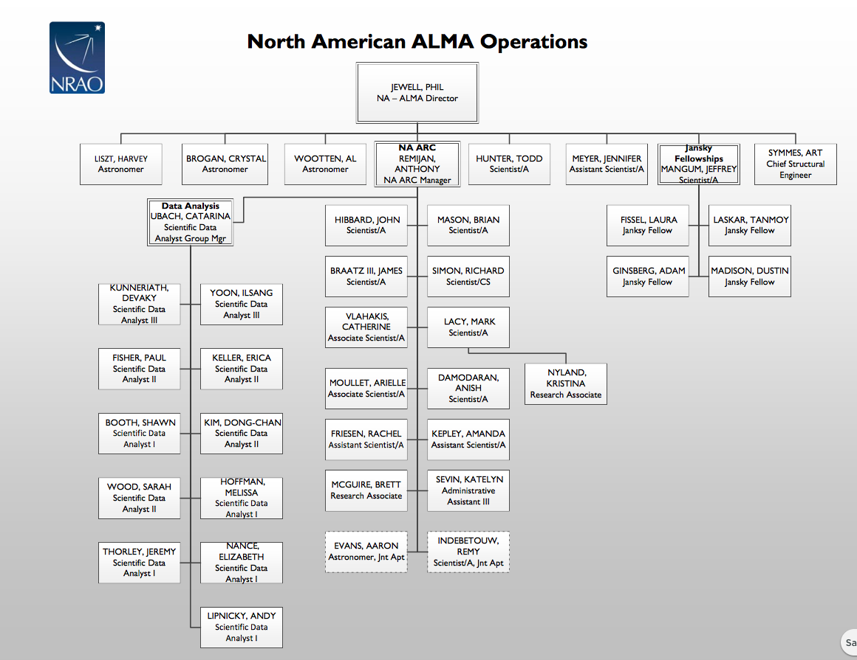
NA ALMA Operations

Slide 20
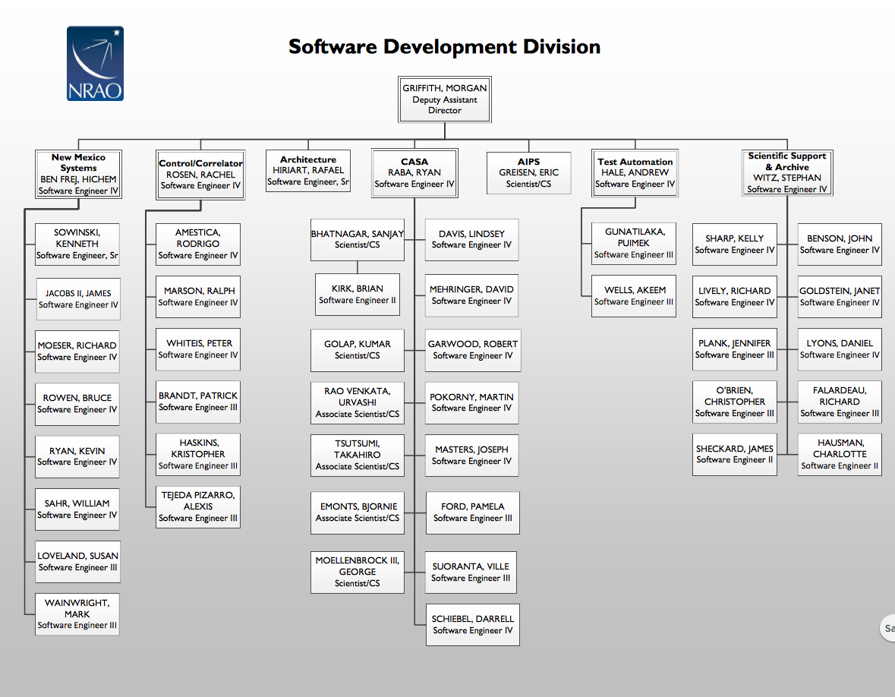
DMS Software Division

Slide 21
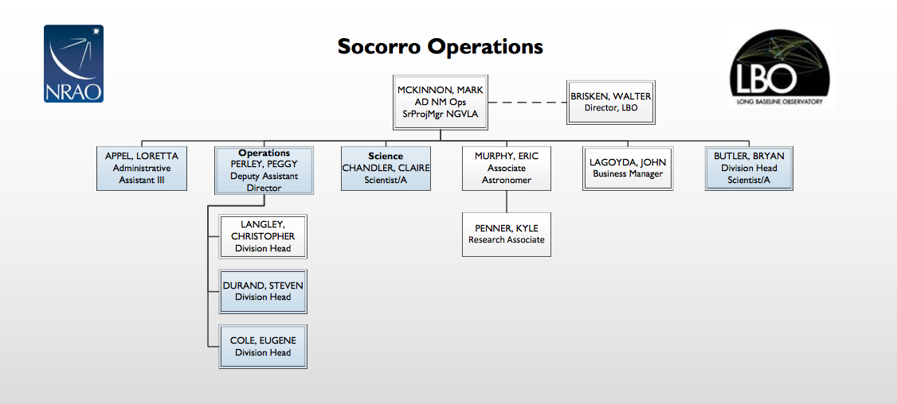
NM Operations

Slide 22
