Slide 1
SRDP Architecture RIDs
Rafael Hiriart

Slide 2
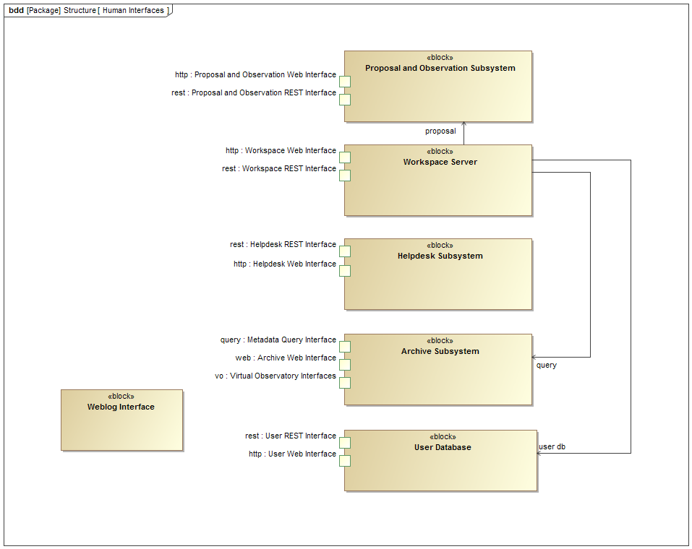
Interface diagrams
SRDP-9

Slide 3
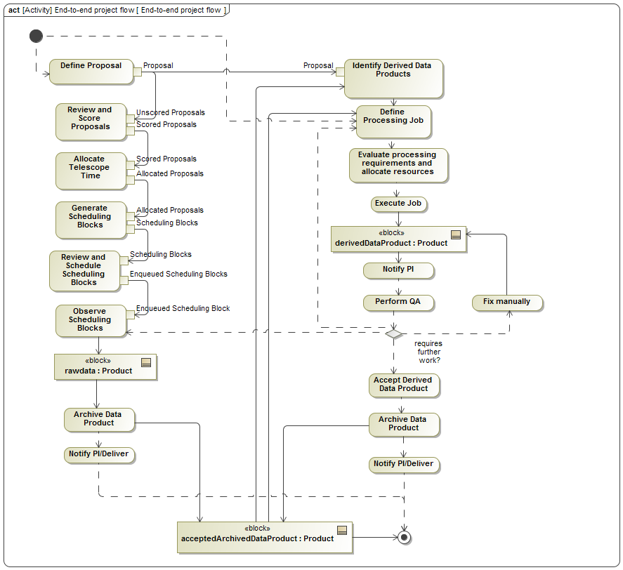
End-to-end project flow
SRDP-54

Slide 4
Have there been prototyping efforts?
SRDP-35
The standard calibration and imaging pipelines for ALMA and VLA.
The VLA Sky Survey management system (https://archive-new.nrao.edu/VlassMngr).
The NRAO Archive Access Tool (https://archive-new.nrao.edu).
The execution of the pipelines in AWS and XSEDE has also been prototyped.

Slide 5
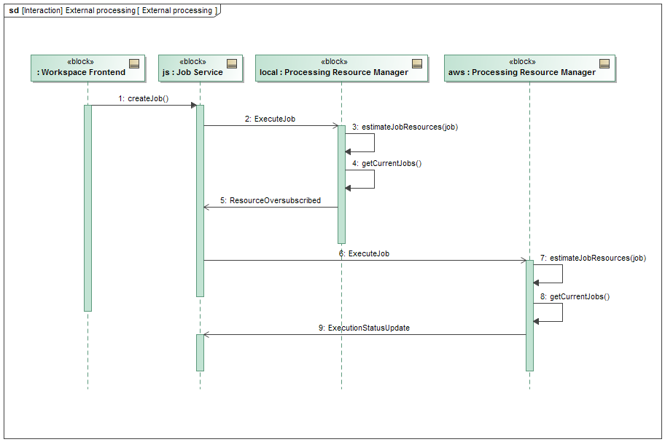
Hardware management
SRDP-47
Agreed, we need to develop an operations plan for AWS/XSEDE executions. It will be developed during the corresponding “rolled wave”. Allocation example:

Slide 6
Information on processing
SRDP-48
Expected products and sizes
  Calibration products are relatively small (0.1-1 GBytes).
  Anticipating image volume flow equivalent to raw data (EVLA: 600 TBytes/year, ALMA: 300 TBytes/year), assuming a limit in full spectral resolution cubes.
Expected processing times
  We don’t have specific target defined.
  Need to balance the latency of producing one image (via parallelization) vs the throughput of processing full set of images (via concurrency).
  Balance strategies so imaging takes less than 1 week.
  Parallelization may be unnecessary if a dataset can be imaged in 2-3 days.
Available computing/storage resources
  Table available here.

