Slide 1
VLASS products summary and short-term schedule

Slide 2
Types of products
NRAO: Basic data products
  Calibrations
  QL images
  SE continuum images and component list (1 set per epoch)
  SE Stokes I, Q, U coarse (128 MHz channel, 12-16 channels depending on RFI) cubes (1 set per epoch)
  Combined continuum, coarse cubes [fine cubes (8MHz channels) – on demand?]
Outside groups (CIRADA): extended data products & services
  Source catalogs (combining components, candidate host IDs) for QL and SE.
  Cutout server
  Polarization RM analysis products
  Transient marshall

Slide 3
Computing resources per product
QL calibration and imaging can easily be handled by NRAO clusters.
For SE continuum, two types of processing due to need for w-term corrections for low elevation (<~45 deg) images (~half the sky).
  Mosaic gridder – “easy” – run time ~6d on one CPU core, 64 GB RAM, 130GB disk/SSD, can run 12 jobs/node.
  AW-project – “hard” – run time ~4d, one CPU core, one GPU (L4), 9GB GPU memory, ~64 GB RAM, 130GB disk/SSD. Or 12 cores CPU, ~8d runtime. (all to be confirmed). Only 2 jobs per node of either type at NRAO.
SE coarse cubes.
  Mosaic gridder, run time ~3d, 4 cores/job, 256 GB RAM, 150GB disk (3 jobs/node at NRAO).
CE continuum and cubes – via image combination initially. Visibility combination will need AW-project and ~3x gridding.

Slide 4
Why is VLASS processing so hard to outsource?
Jobs run long (several days/weeks). No checkpointing in the pipeline means use of spot markets etc is ineffective.
To fully utilize ~24 cores, need ~32-64GB RAM per core.
Also need >>1TB of fast storage on each node.
NRAO’s NM Tech cluster has 30 24-core nodes with 768GB RAM and 5.8TB storage/node (we also have another 30 similar nodes at NRAO/DSOC that connect to a shared filesystem).
  Very hard to match elsewhere in academic or commercial clouds, which tend to have much less memory per core and less attached storage.
  We are talking with CHTC (Wisconsin) and others – some products could be feasible, if somewhat inefficient, to run on external clusters.

Slide 5
Near-term plan (next 2 yr)
SECI -> ~May 2024 – have 1100 1300 images available, another 1200 ~1000 awaiting QA
  Will run many more once new diskspace (on order) is installed in Socorro.
  ~6000 deg² remaining of 2.1 with the mosaic gridder, should hit ~2000 deg² /month.
  Pause (mostly) during 3.2 QL (May 8th - Oct).
Polarization cubes
  Pipeline improvements in place, validation completing.
  Need to work on QA process.
  Most likely will wait until after 3.2 (so fall/winter 2024) and focus on data run through the mosaic gridder 2.1 SECI (need the SECI self-cal solutions).
High performance (GPU) gridder needed for rest of 2.1, in test now, expect move to pipeline in Fall 2024. However, ~<30 GPUs available then, will restrict us to only ~200 images/month.
  Probably means focus on 2.1 cubes based on mosaic SECI (~ 1000/month) and 2.2 mosaic gridder SECI (~1000/month) in 2025.

Slide 6
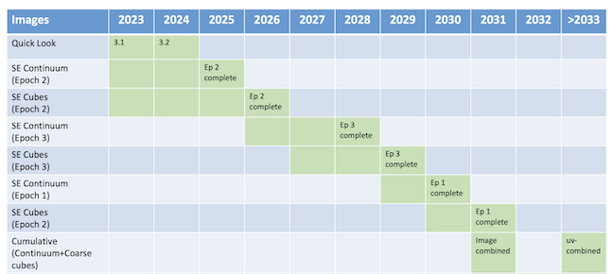
Long-term
Fine cube implemnetation
Epoch 4, if approved, results in ~ 1 year bump out from ~2027/8, switches E1 SE to E4 SE (E1 SE descoped).
Fine cubes will be from on-demand processing.

Slide 7
Long-term improvements
Expect more GPU availability, both for us (via RADIAL) and from other academic/commercial clusters over next ~10yrs.
Will investigate different imaging algorithms that use machine learning for deconvolution (e.g. POLISH).
  Speculative – quantitative reliability of these algorithms unclear, have only been tested on simulations or very limited observational datasets.
  Will need to be able to deal with wideband data (via multiple channels?) for spectral indices. Ideally Stokes IQU too.
  If they work, could reduce the computing needs for AW-project by ~x10.
  Help welcome!!!

